Slide 1
Oliver Wyman Application for Data Scientist Case Study Round
By
ASTHA PANT

Slide 2
Process Flow
Historicals
Data Analysis
Alternate Methodologies
Strategies
forecast
Details of prospective additional models that can be used for prediction with their pros and cons.
Curated Data Insights on varied levels to analyze the features and gauge the interdependence of variables.
Data Overview
GAC Forecast
Solution Devised
Historicals
Improvement Areas
Carrier Forecast
Case Study workflow and detailing the models deployed for training and obtaining results.
Understanding Case Study background and scope with an overview of data depth.
Pertinent areas where the approach can be improvised and performance can be increased.

Slide 3





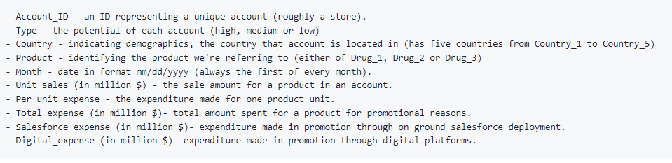

Data Overview
The data primarily consists of the following files:
Account level historical sales data for 8 years for the products Drug_1 and Drug_2.
Sales data for a new product launched in the market (Drug_3).
Potential of each account available based on patient size - classified into high, low and medium.
Promotional Expenses for each product in each account and the split numbers into Salesforce and Digital expenses.
.
5 Countries
125 Accounts
3 Drugs
Data Fields
8 Years Historicals
3 Account Potentials

Slide 4
Exploratory Data Analysis

Slide 5
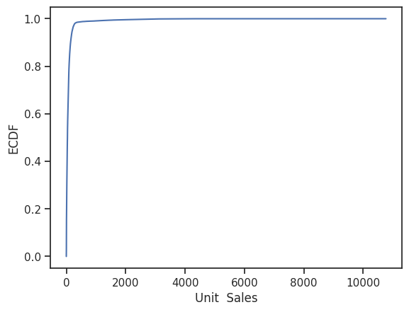
Data Visualization: Overall Sales Distribution
Empirical Cumulative Distribution Graph
Majority cumulative distribution captured initially
Although the highest monthly sales exceeded the massive figure of 10,000 million dollars, it is interesting to note that more than 90% of the data had monthly sales less than ~ 1000 million dollars.

Slide 6
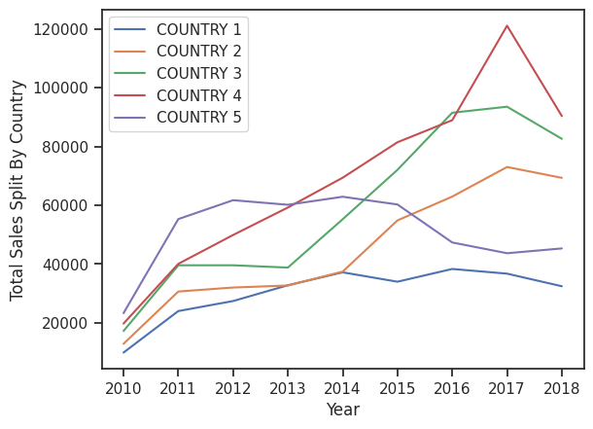
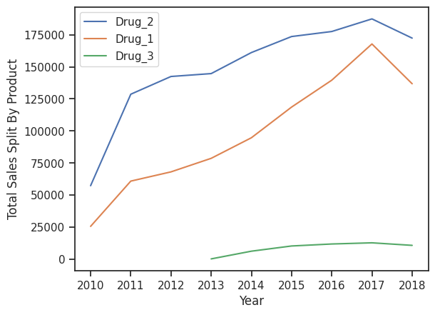
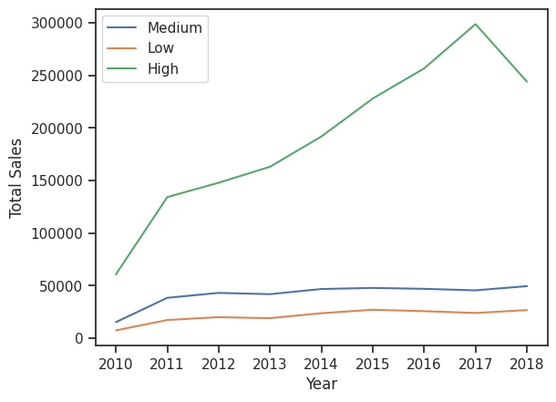
Analyzing Sales: Different Perspectives
Country
Drug
Countries 2,3 and 4 have had a somewhat steady increase in the drug sales.
Country 1 and 5 have experienced a decrease in its sales in the latter half of the decade.
Majority of the sales have been recorded for Drug-2 followed by Drug-1.
Drug-3 has recorded relatively lower levels of sales.
Account Level
Intuitively, High potential accounts have recorded the maximum sales with a steady increase upto the year 2017. It has recorded a significant dip of around 16% in its total sales in the year 2018.
Medium and Low potential accounts have had a relatively steady sale progress.

Slide 7
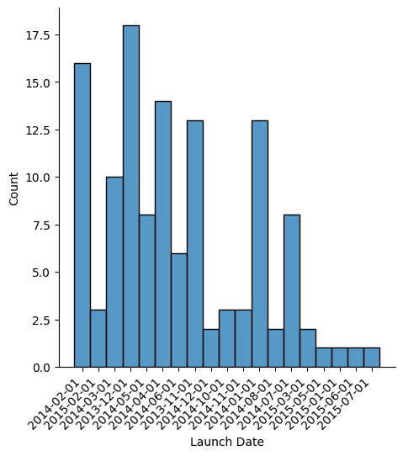
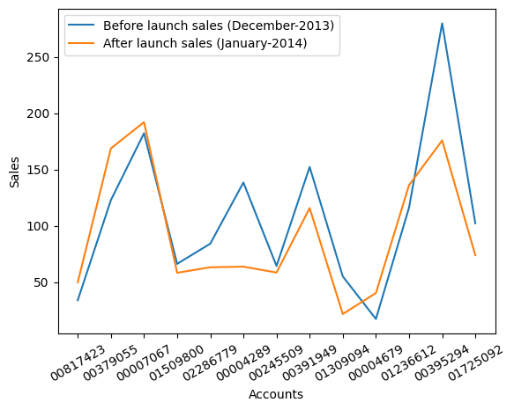
Sales Impact Due to Launch of Drug-3
Launch Dates for Drug-3
Sales Impact due to launch of Drug-3
The y-axis refers to the number of accounts wherein Drug-3 was launched on that particular date.
The major launch of this product took place in 2014 itself, with some launch dates also extending into 2015.
The above graph shows comparison in the sales of Drug-2 in December 2013 vs January 2014, i.e., before and after the launch of Drug-3.
8 out of the 12 stores took a dip in the sales of Drug_2 after the launch of Drug_3 in January 2014.

Slide 8
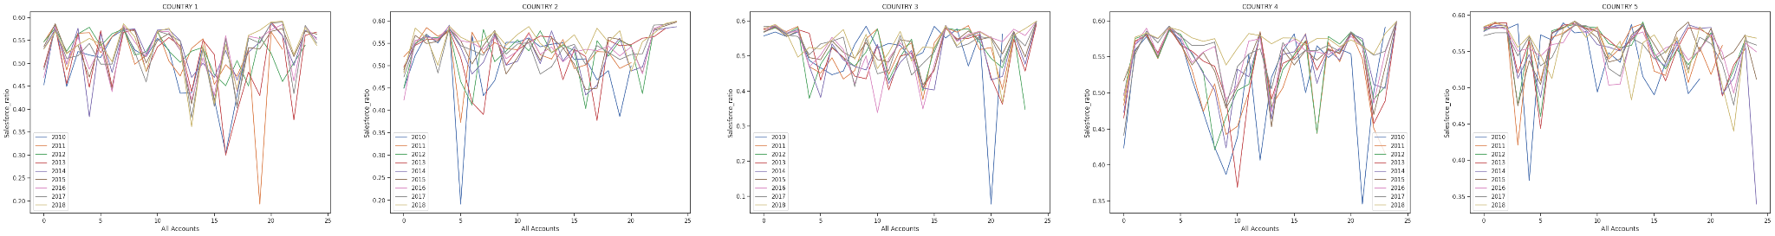

Analyzing Salesforce Ratio
Drug-1
For all the countries, the salesforce ratio has been majorly between 0.45 to 0.55 - indicating a somewhat equal distribution of funds in on-ground and digital promotion. However, for Country-5 this ratio has been nearly around 0.6 for a significant part of the decade, indicating more on-ground promotional expenses.

Slide 9
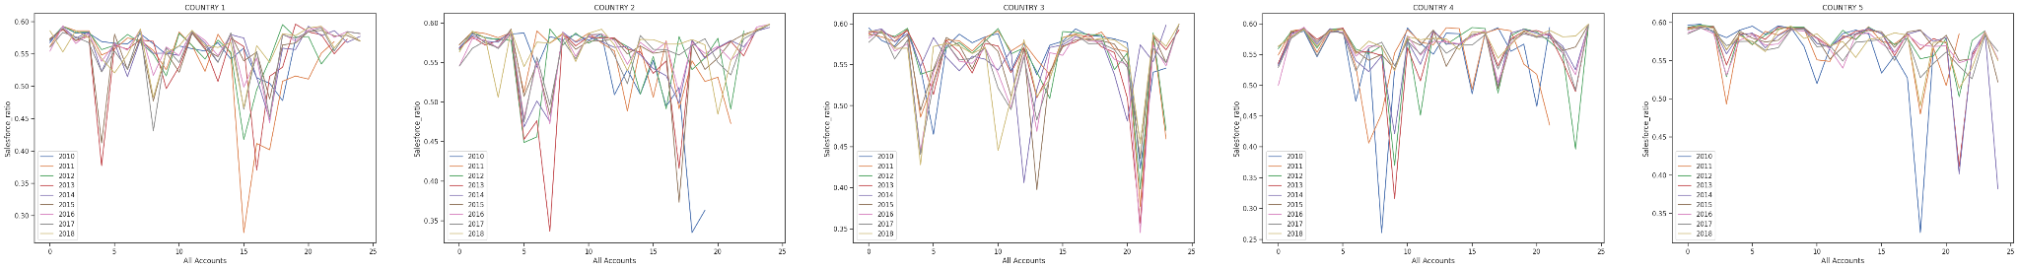
Analyzing Salesforce Ratio
Drug-2
For Drug-2, we see this ratio majorly touching 0.6 for all the countries (except for some outliers). This points towards more on-ground promotional activities for Drug-2 in the five countries.

Slide 10
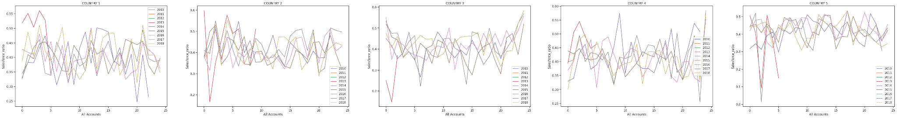
Analyzing Salesforce Ratio
Drug-3
Interestingly, the salesforce expenses are a bit on the lower side for Drug-3. The mean value has been between 0.35 to 0.5, indicating higher digital expenses for Drug-3. At this point, one should note that Drug-2 has recorded the maximum sales in different accounts whereas Drug-3 has recorded relatively skewed sales figures.
This might indicate towards a positive correlation between salesforce expenses and the total drug sales recorded.

Slide 11
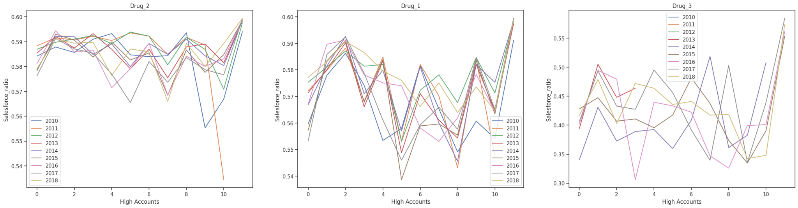
Analyzing Salesforce Ratio: High Potential Accounts
This trend is similar to what has been observed for all the accounts in the previous analysis of salesforce ratio for individual drugs.

Slide 12
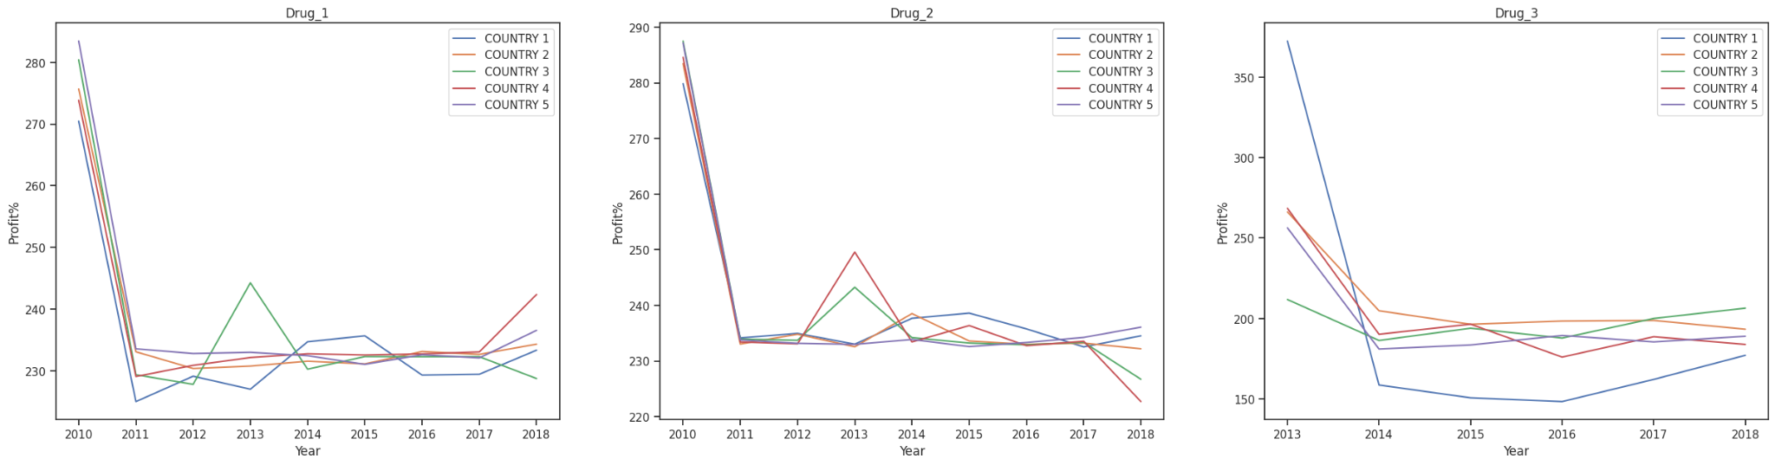
Profit Analysis Of Different Drugs
Profit Percentage for Drugs in Different Countries
Drug-1 and Drug-2 yield similar profits across all countries.
However, there are high profits for Drug-3 during launch- which dips highly in the subsequent years.
Interestingly, Drug-1 and Drug-2 have not taken any significant hit in it Profit% after the release of Drug-3 in 2014.

Slide 13
Solution Approach

Slide 14
Feature Engineering
Future Expenses Computation
Lag Features
01
02
03
Values of Total Expenses, Salesforce and Digital Expense calculated at prior time steps. Time Steps taken: 1,2,3,6 and 12 months.
Capture Seasonal Monthly Variation
Value of the total Expenses for the specific month last year.
Accommodating Both
Averaging both degree of variations to get the potential final value of future month. .
Capture Year Trend
Mean of the total expenses for the year 2018 from January to October.
DateTime Features
Created from the monthly timestamp value of each account in the data.
Week of the year
Quarter
Is Month Start Boolean
Is Year Start Boolean
Is Quarter Start Boolean
Features Added To Data
Test Data
Validation Data - Jan’18 to Oct’18
Data Split as per Monthly Timestamp
Training Data- From 2011 to December 2017
Moving Average Features
Rolling Method deployed to derive the moving averages for all expenses. Rolling WIndow : 3 months.
Original Data - Expense File 2011-2018 Sales Information

Slide 15
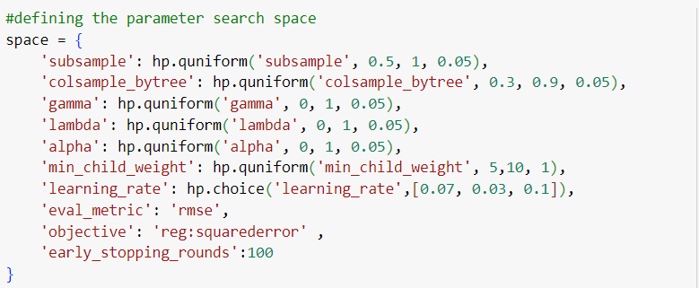
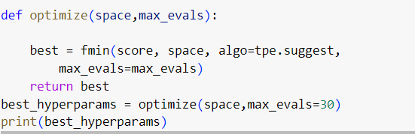
Solution Devised - Methodology
Deployed the XGBoost (Extreme Gradient Boosting) algorithm to make forecasts on the data. Trained with the XGBoost API to create the model object and then configured the hyperparameters to improve model performance.
Feature Engineering
Code Snippet - Hyperopt
Solution Structuring
Data Split and Hot-Label Encoding
Training the XGBoost with the default hyperparameters.
Performing K-Fold and tuning the hyperparameters using GridSearchCV
Model Deployment
Deploying Hyperopt to get better accuracy yielding hyperparameters.
Final Output Format
 | Week | Sales | Up- Sales | Low-sales
Account1
Account2
The final prediction intervals are calculated by computing the upper and lower intervals of total expenses.
Upper = Mean +Standard Deviation Lower = Mean -Standard Deviation
Predicting on the Test Data for final Output

Slide 16


Hyperparameter Tuning
Hyperparameter Tuning selects the optimal values for training the XGBoost model. Here, tuning is done using scikit-learn’s GridSearchCV and also with the automated tool Hyperopt. The obtained parameters values with which the final model is trained are:
Primary Hyperparameters
Subsample : 0.7
Column Subsample: 0.75
Fraction of samples for each iteration and fraction of features for each tree.
PRIORITY STRATEGIES
Learning Rate: 0.03
01
04
Step size at which the algorithm makes updates to the model weights. (Shrinking factor)
Maximum Depth: 3
Regularization Parameters
lambda: 0.1 and alpha: 0.15
The maximum depth of the tree. A higher value was giving high error due to overfitting
02
05
Adding the L1: Lasso and L2: Ridge regularization terms to prevent overfitting by penalizing the weights
Minimum Child Weight: 51
Number of Estimators: 1000
03
06
Minimum number of samples in each leaf node required for it to split. Values >50 yield better results in the model.
Tells the number of trees to build - indicating the boosting rounds, Higher value increases computation time

Slide 17
Alternate Methodologies
ARIMA
LightGBM
Can capture the linear relation in data well.
Not highly sensitive to outliers, can deal with randomness and noise in dataset.
It cannot work with non-stationary data; thus requiring to difference and make the data stationary before modeling.
Cannot forecast for long timeframes.
Setting up the optimal parameters is a rigorous task
Gradient Boosting ALgorithm, has less computational cost and can work on large datasets efficiently.
Can capture complex relationships among data variables.
Can lead to overfitting, if the model is not well tuned
Large number of hyperparameters to cater to, increasing model complexity.
Prophet Model
LSTM
The model can easily capture trend and seasonality patterns across the data (by additive decomposition and multiple seasonality features).
Can detect outliers efficiently.
It cannot predict complex relationships between variables thus rendering inaccurate at times.
Requires large amount of historical data.
Can handle complex data patterns, even in large datasets.
Does not require separate feature engineering before training.
Can be trained for image, text or numerical inputs.
Highly sensitive to noisy data or outliers.
Requires a high amount of data for training to yield good accuracy.
Notes:
Safari 375ml is not in the priority list for NW
Balimi is not in the priority list in North East

Slide 18
Improvement Areas
Can make use of other modeling techniques focused for time series data like LightGBM, Lasso/Ridge Regression, LSTM and take the Ensemble of all predictions as the final forecast.
Although XGBoost takes care of seasonality and trend but making the data stationary before training the model and then adding the trend and seasonality components later on might have resulted in better results. However this is more pertinent to ARIMA model (the lagged features in our model mitigate the non-stationarity of data).
Next task is to analyze the Cross Validation folds - if a different method of split can improve model performance. Currently, used the TimeSeriesSplit.
The iteration steps in Hyperopt hyperparameter tuning can be increased for reduced RMSE. However this may increase the computation time drastically.
The prediction intervals can be calculated through quantile regression, by fitting at the 5th and 95th percentiles to give a 90% prediction interval.
Can use other methods of evaluating the error and model performances apart from the standard errors.
Prophet Model
Notes:
Safari 375ml is not in the priority list for NW
Balimi is not in the priority list in North East

Slide 19
THANK YOU!
…

